Slide 1

Rationale
Introduction to Windows Store App Development Using HTML5 and JavaScript
Computer science is a field of study that deals with solving a variety of problems by using computers.
  To solve a given problem by using computers, you need to design an algorithm for it.
Multiple algorithms can be designed to solve a particular problem.
An algorithm that provides the maximum efficiency should be used for solving the problem.
  The efficiency of an algorithm can be improved by using an appropriate data structure.
Data structures help in creating programs that are simple, reusable, and easy to maintain.
This module will enable a learner to select and implement an appropriate data structure and algorithm to solve a given programming problem.

Slide 2
Objectives
  In this session, you will learn to:
  Implement toast notification
Notes:
2

Slide 3

Implementing Toast Notifications
  Toast notifications are:
  Displayed to a user with a higher priority than the work the user is currently doing.
  Displayed, irrespective of the fact whether the user is in some other app, on the Start screen, or on the desktop.

Slide 4
Introduction to Toast Notifications
Toast notifications
Are raised when you want to notify the user about something of high priority.
Can be
A standard notification.
A long-duration toast notification.
7 Seconds
25 Seconds

Slide 5

Just a Minute
  The ___________ toast notification is displayed on the screen for seven seconds.
  1. Standard
  2. Long-duration

Slide 6
Just a Minute (Contd.)
  Solution:
  1. Standard

Slide 7
Declaring the Capability to Raise a Toast Notification
  To set whether the app can raise a toast notification, set the Toast capability in the package.appxmanifest file of an app.
  Once the value is set, your app is added to the Notifications section of the PC settings window.
  In the Notifications section of the PC settings window:
  You can enable or disable the toast notification for the app depending upon the requirements.

Slide 8
Task: Setting the Toast Capability
Let us set the toast capability of an app

Slide 9
Task: Accessing the Notification Sections for PC Settings
Let us access the Notifications sections for PC settings

Slide 10
Introduction to Toast Templates
  The following types of templates are available for toast notifications:
Text-only templates
ToastText01
ToastText02
ToastText03
ToastText04

Slide 11
Introduction to Toast Templates (Contd.)
Image-and-text templates
ToastImageAndText01
ToastImageAndText02
ToastImageAndText03
ToastImageAndText04

Slide 12
Sending a Toast Notification
To send a toast notification:
Declare a namespace variable.
Identify the template.
Set the image for the notification.
Set the duration.
Set the audio.
Set the text for the notification.
Send the toast notification.
Create the toast notification.

Slide 13
Sending a Toast Notification (Contd.)
Let us look at an example, which sends a toast notification

Slide 14
Summary
  In this session, you learned that:
  To send a toast notification, you need to:
    Declare a namespace variable.
    Identify the template.
    Set the text for the notification.
    Set the image for the notification.
    Set the duration.
    Set the audio.
    Create the toast notification.
    Send the toast notification.
Notes:
14

Slide 15
What’s Next?
  You need to perform Exercise 3 of IWSADHJ Chapter 9 in the MR session.
  In addition, you need to perform the following exercises of IWSADHJ Chapter 10:
  Exercise 1
  Exercise 2

Slide 16
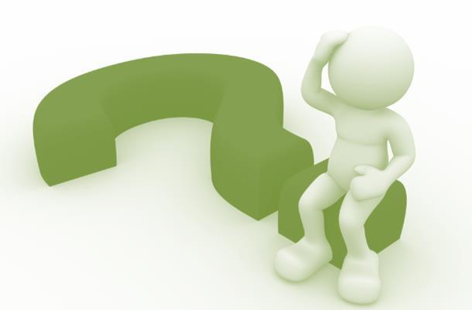
Q&A

